Slide 1
Low-Power Wide-Area Networks
Alexander Pelov (a@ackl.io)
RIOT Summit 2016
Berlin, July 15

Slide 2
SIGFOX
LoRa
NB-IoT
Weightless
RPMA

Slide 3
Low-Power Wide-Area Networks

Slide 4
25 mW transmission power
Low-Power Wide-Area Networks
20 years on simple battery

Slide 5
15-50 km rural outdoor
Low-Power Wide-Area Networks
2-3 km urban indoor

Slide 6
No scheduling
No routing
ALOHA
Low-Power Wide-Area Networks
Device-initiated com
Huge densities
Low throughput

Slide 7
250 kHz or less
Narrow-band
Low-Power Wide-Area Networks

Slide 8
Collisions
Data-over-NAS
In-band
Duty cycling
Acknowledgements
Guard-bands
License free
In licensed spectrum
250 kHz or less
Narrow-band
Low-Power Wide-Area Networks

Slide 9
Collisions
Data-over-NAS
In-band
Duty cycling
Acknowledgements
Guard-bands
License free
In licensed spectrum
Narrow-band
No scheduling
250 kHz or less
No routing
25 mW transmission power
15-50 km rural outdoor
ALOHA
Low-Power Wide-Area Networks
20 years on simple battery
2-3 km urban indoor
Device-initiated com
Huge densities
Low throughput
100 bps
12 byte payload
140 messages
4 messages
(50 kbps max)
(50 byte payload)
uplink
downlink

Slide 10
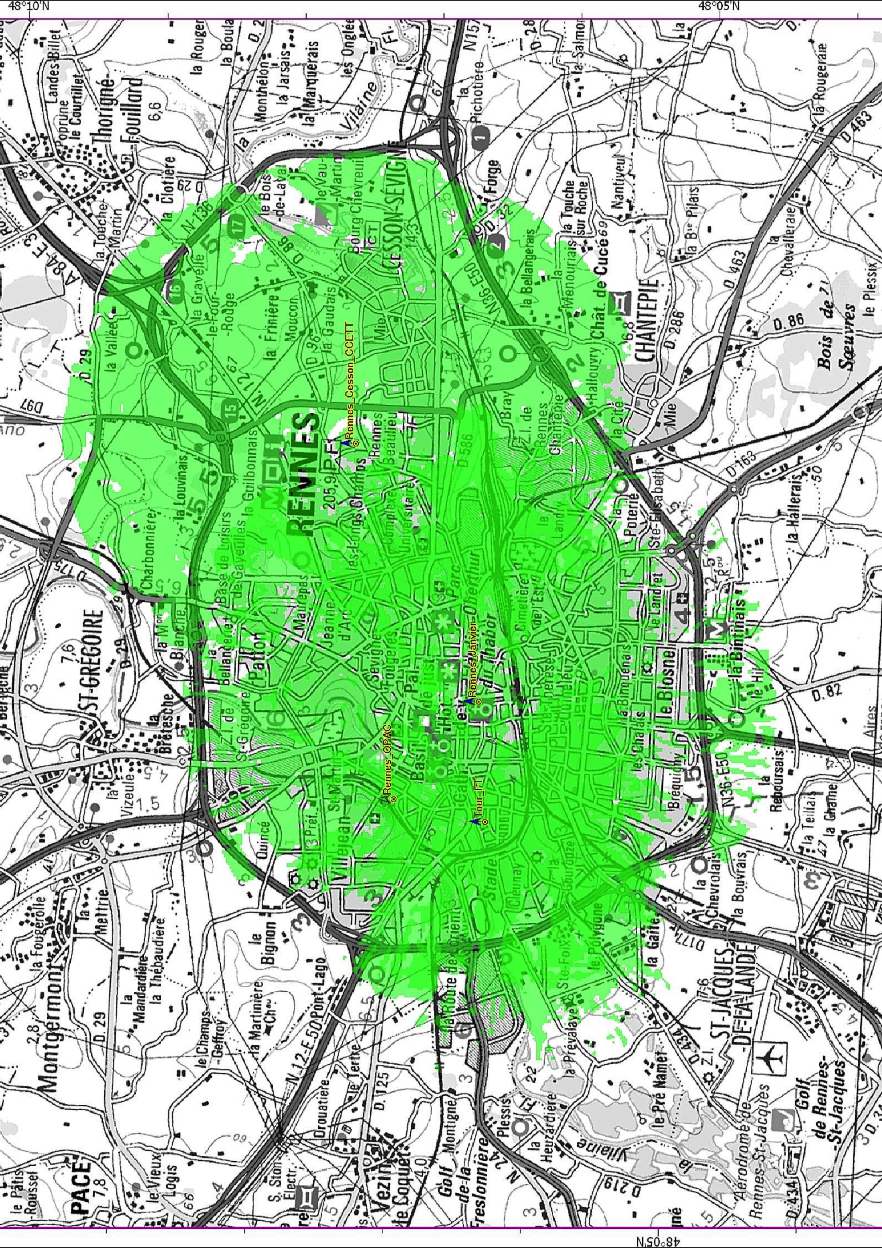
11km

Slide 11
Source : SNS Research, November 2015

Slide 12
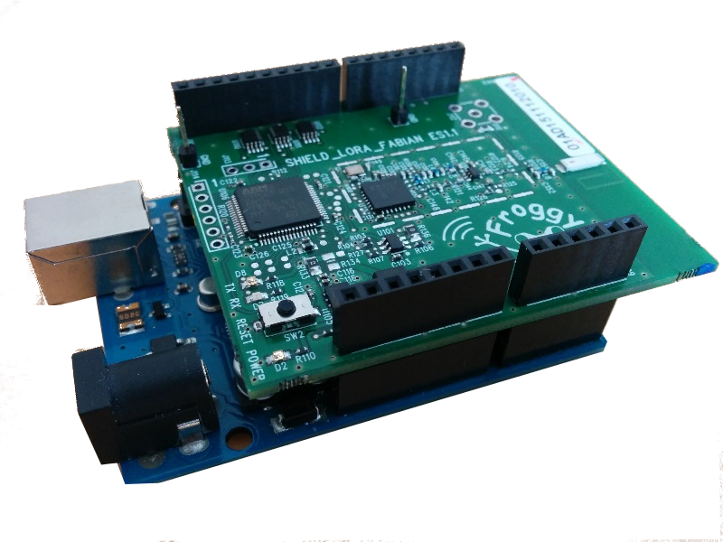
LPWAN-GW
App Server
Radio-GW

Slide 13
Compression
CoAP
CoAP
UDP
UDP
IP
IP
MAC
MAC
PHY
Internet
PHY

Slide 14
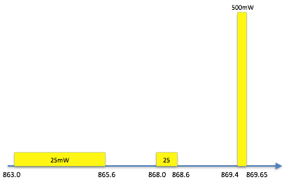
Management

Slide 15
Building the next 10 bln devices
Device software stack
  Drivers (available for Contiki)
  MAC (e.g. LoRaMAC – open C implementation)
  IP/UDP/CoAP with SCHC IP compression
  CoOL/CoMI for network and app management
  RESTful APIs
  Certificates, COSE, secure element, code verification
    Design for disposable devices + devices that will be there for 10+ years
Development tools!
  Independent of LPWAN technology
But wait, there is more…
  6TiSCH

Slide 16
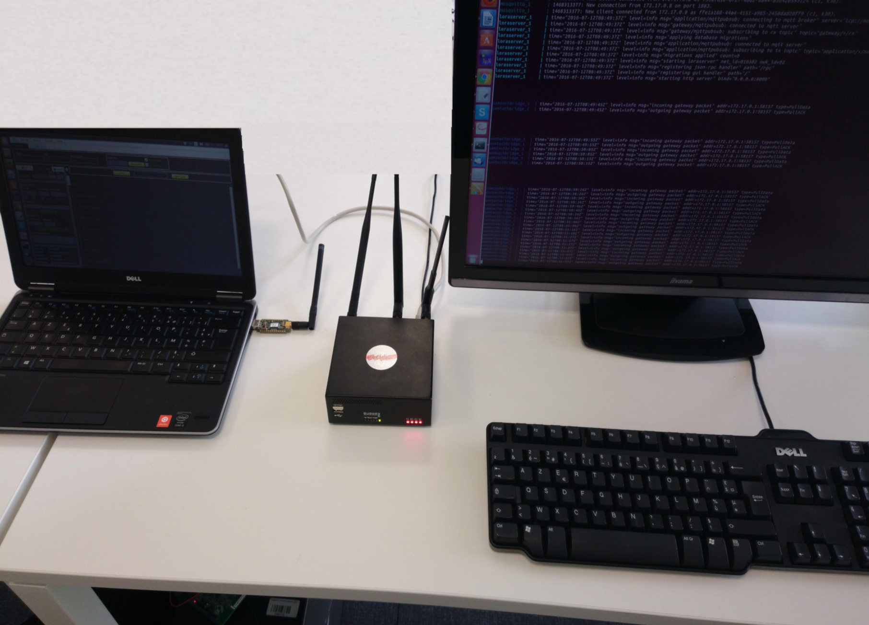
Thank you! Questions?
IETF LPWAN BoF on Monday
Join the lp-wan mailing list
Technical session on Sunday
Key documents:
  draft-toutain-6lpwa-ipv6-static-context-hc
  draft-gomez-lpwan-fragmentation-header
CoOL/CoMI on CoRE:
  draft-ietf-core-yang-cbor
  draft-veillette-core-cool
  draft-somaraju-core-sid

